Slide 1
How PCR Works
By
Ram Balak Mahto
Guest faculty
Zoology department
V.S.J College Rajnagar Madhubani
B.Sc 2nd yr gen/sub

Slide 2
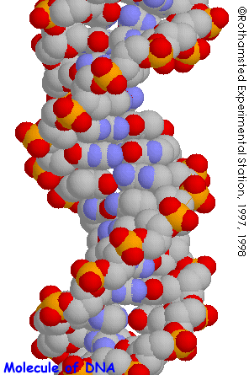
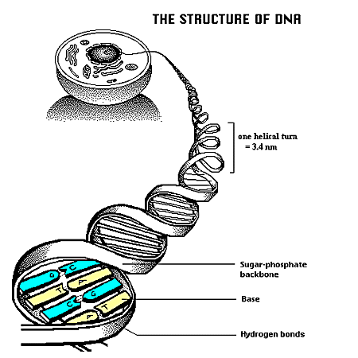
Structure of DNA
Double
Helix
Complementary Base Pairing

Slide 3
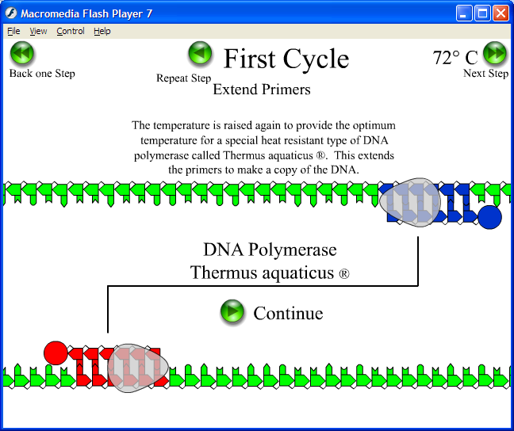

Slide 4
The PCR Reaction Chemistry
PCR Reaction Components
Water
Buffer
DNA template
Primers
Nucleotides
Mg++ ions
DNA Polymerase

Slide 5
Water
The medium for all other components.
Buffer
Stabilizes the DNA polymerase, DNA, and nucleotides
500 mM KCl
100 mM Tris-HCl, pH 8.3
Triton X-100 or Tween

Slide 6
PCR Reaction: Template DNA
Water
Buffer
DNA template
Contains region to be amplified
Any DNA desired
Purity not required
Should be free of polymerase inhibitors

Slide 7
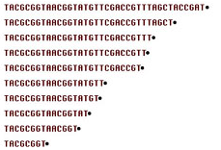
Water
Buffer
DNA template
Primers
Specific for ends of amplified region
Forward and Reverse
Annealing temps should be known
Depends on primer length, GC content, etc.
Length 15-30 nt
Conc 0.1 – 1.0 uM (pMol/ul)
PCR Reaction: Primers

Slide 8
PCR Reaction: Nucleotides
Water
Buffer
DNA template
Primers
Nucleotides
Added to the growing chain
Activated NTP’s
dATP, dGTP, dCTP, dTTP
Stored at 10mM, pH 7.0
Add to 20-200 uM in assay

Slide 9
Water
Buffer
DNA template
Primers
Nucleotides
Mg++ ions
Essential co-factor of DNA polymerase
Too little: Enzyme won’t work.
Stabilizes the DNA double-helix
Too much: DNA extra stable, non-specific priming, band smearing
Used at 0.5 to 3.5 uM in the assay
PCR Reaction: Magnesium

Slide 10
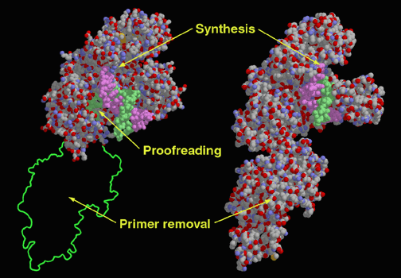
Water
Buffer
DNA template
Primers
Nucleotides
Mg++ ions
DNA Polymerase
The enzyme that does the extension
TAQ or similar
Heat-stable
Approx 1 U / rxn
PCR Reaction: Polymerase

Slide 11
PCR Reaction Components
Summary:
Water
Buffer
DNA template
Primers
Nucleotides
Mg++ ions
DNA Polymerase

